Slide 1
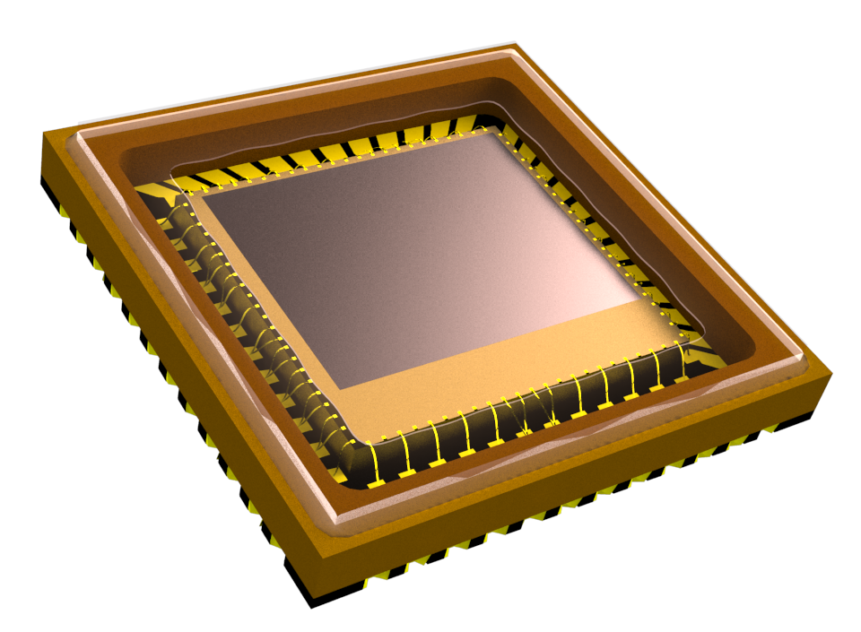
Image Sensor Defect Detector
DSI10 SG Capstone project

Slide 2
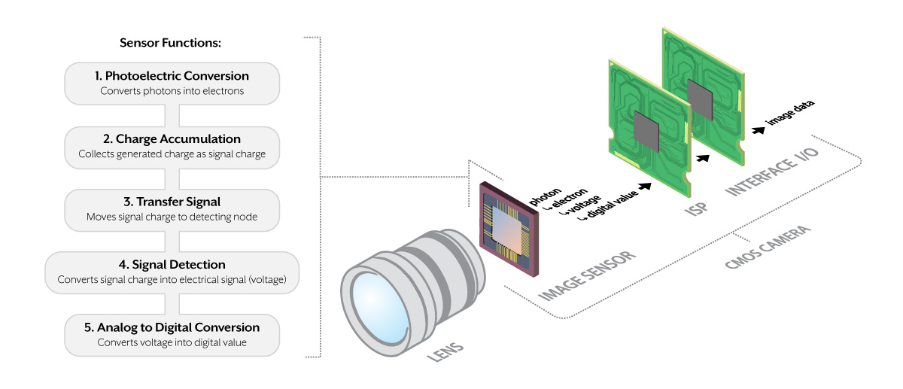
Image Sensors

Slide 3
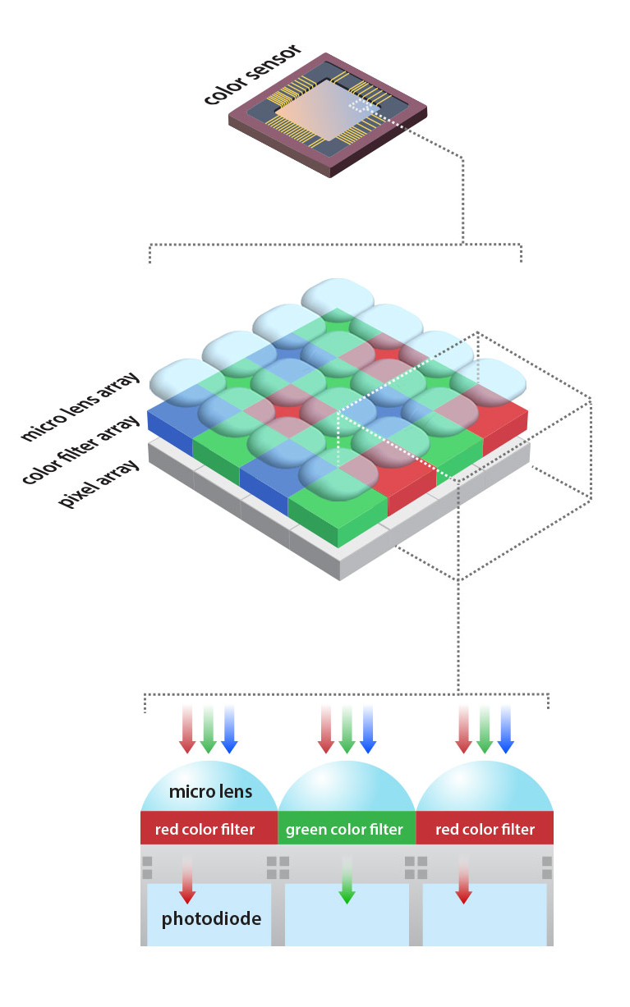
Image Sensor
Macro View of Single Pixel
Complex to manufacturing process and expensive
Good sensors are expensive
Used in critical system (Automotive, Medical, Aerospace, Defence..)
Testing process is expensive and time consuming

Slide 4
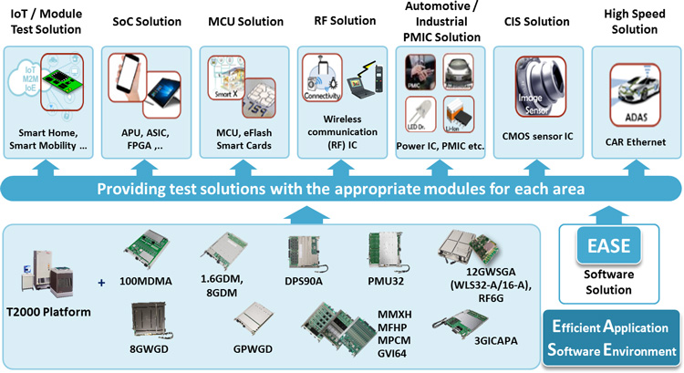
Image Sensor Testing
Automated Test Environment are used to test every sensors before reaching consumers.
ATEs and testing phase are very expensive, chip makers are looking for ways to cut cost at every turn.
Up front cost to setup test floor is very high each ATE could cost in millions depends on the configuration, let alone the operating cost.

Slide 5
Problem Statement
Manual image checking work flow by human eye is time consuming and error prone. Each sitting a staff may need to visually check between 3000 to 4000 images and classify them.
Staffs are subject to suffering from fatigue and unsatisfactory of the nature of the task.
Result is an unreliable work flow causes delay in daily product output delivery to customer.
High wastage due to good products classified as defective.
Build a reliable system to replace the manual image checking work flow.
ATE image sensor testing
Good product Yield at acceptable level?
No
Manually check each sensor image data and classify good / defective products.
Yes
Ready for delivery

Slide 6
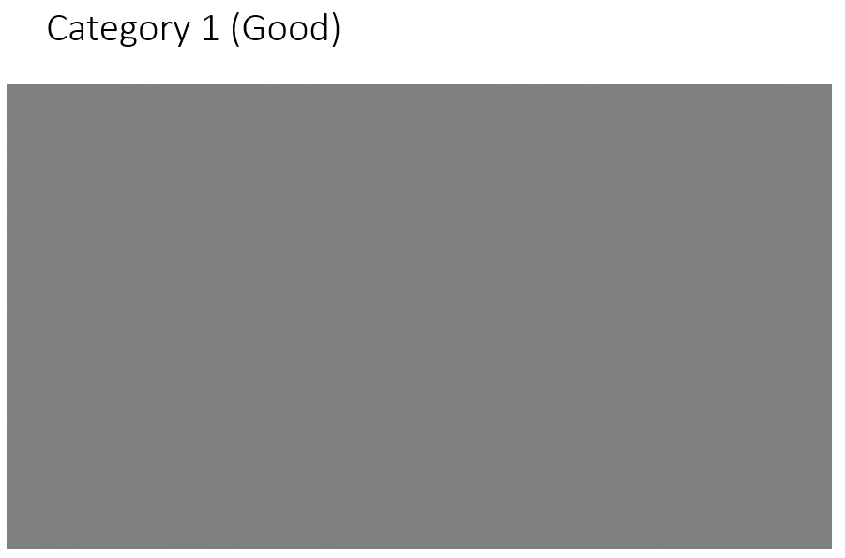
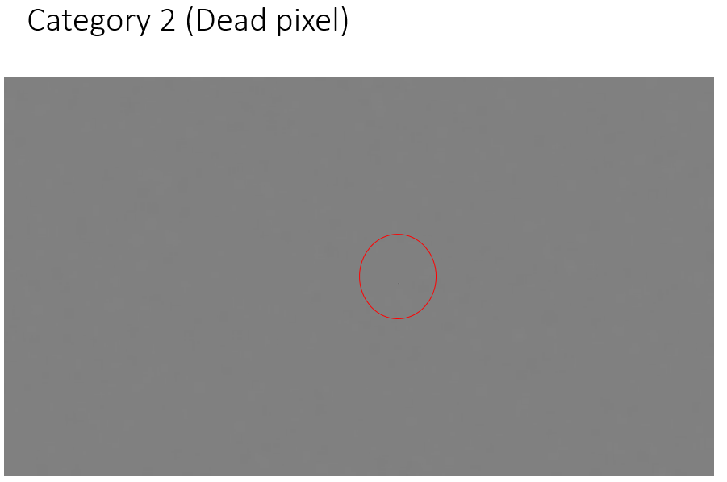
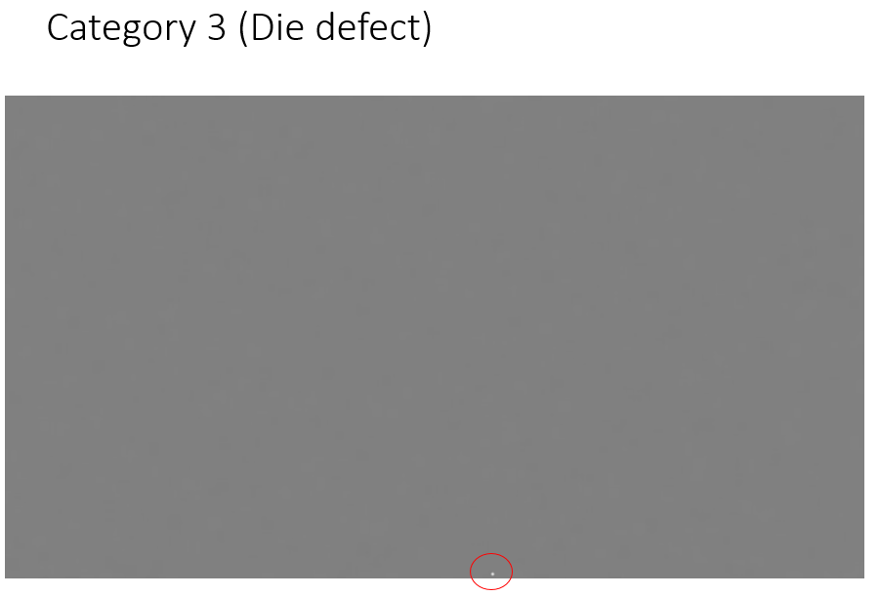
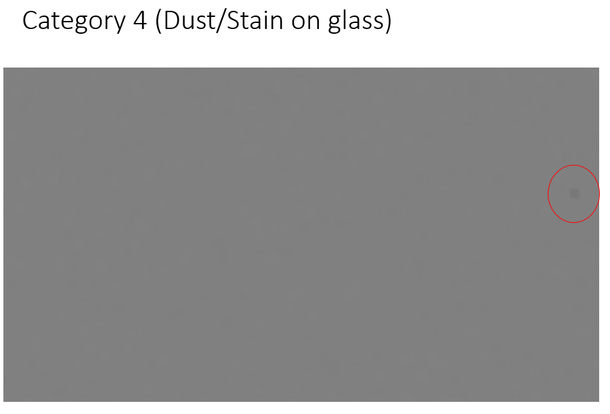
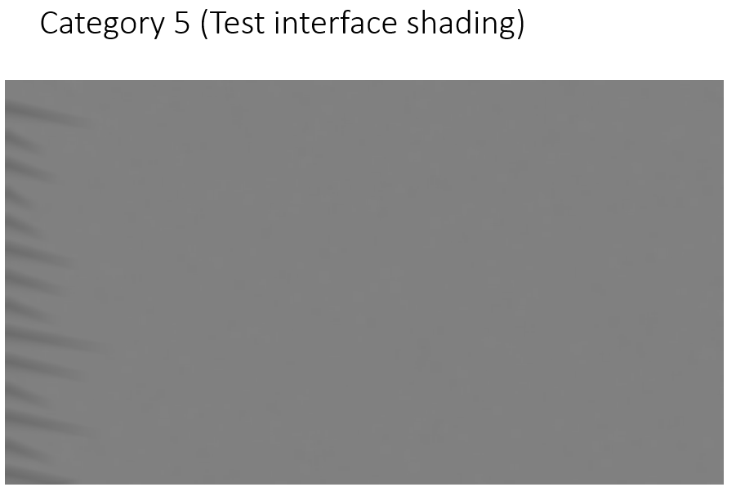
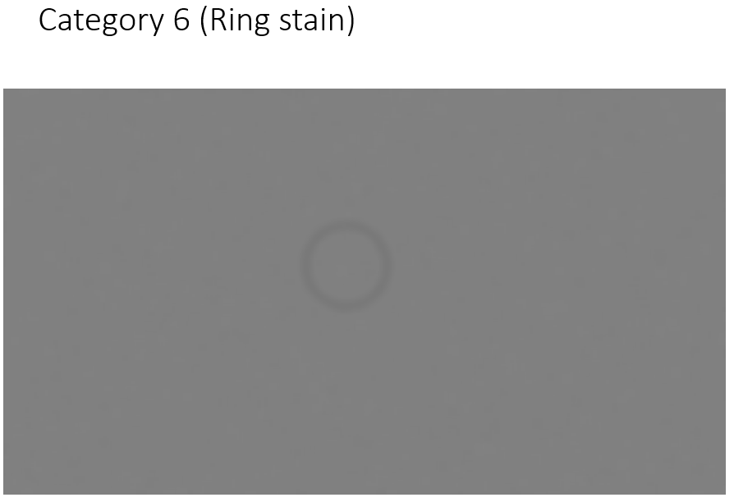
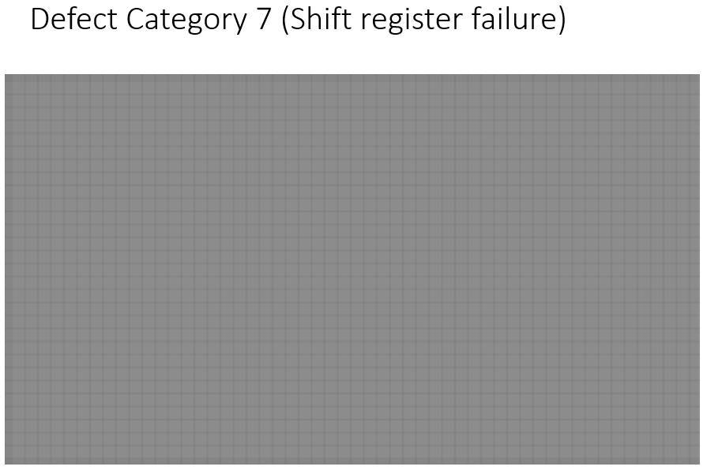
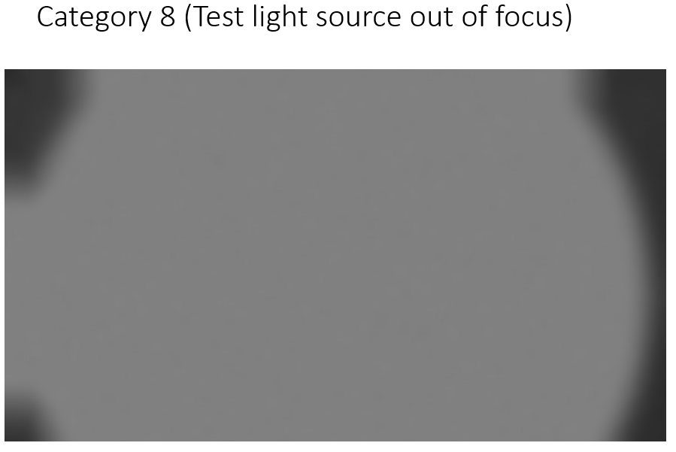
Categories to Classify

Slide 7
Technology Selection
There were two technology paths considered when it came to building a model to classify image data
Machine Learning
Deep Learning
Machine learning models were chosen over deep learning.
In machine learning outcome can be interpreted by the features selected to use. And features can be optimized or new features can be introduced.
Lack of GPU resource to train deep learning models.

Slide 8
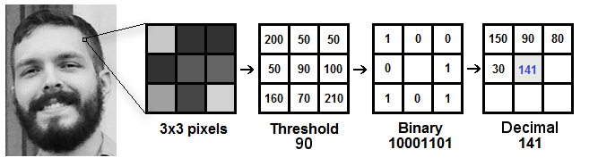
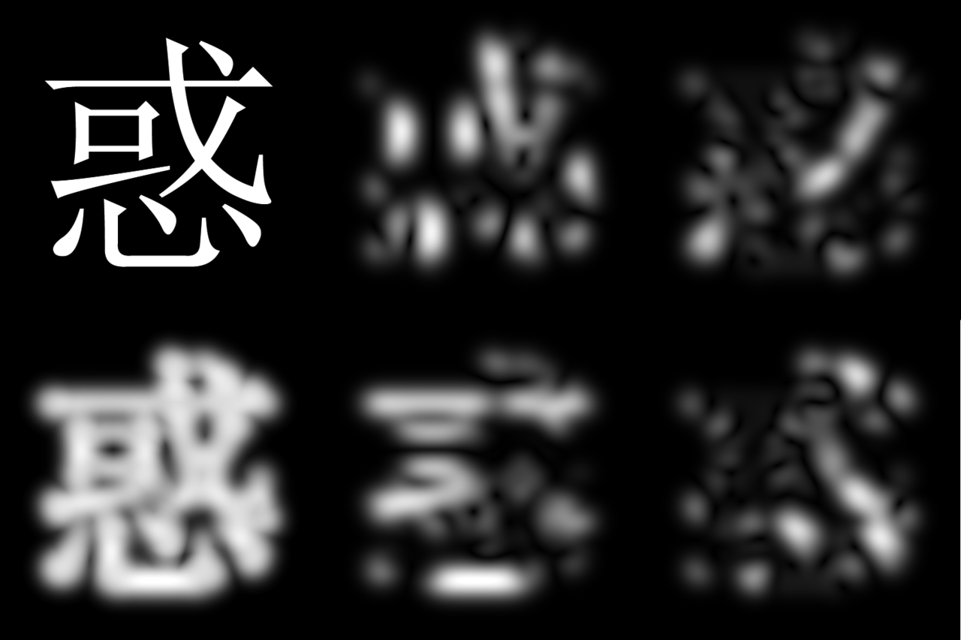
Features
Local Binary Pattern (LBP)
Local Binary Pattern (LBP) is a simple yet very efficient texture operator which labels the pixels of an image by thresholding the neighborhood of each pixel and considers the result as a binary number. It was first described in 1994 (LBP) and has since been found to be a powerful feature for texture classification.
Gabor filter
In image processing, a Gabor filter, named after Dennis Gabor, is a linear filter used for texture analysis, which means that it basically analyzes whether there are any specific frequency content in the image in specific directions in a localized region around the point or region of analysis.

Slide 9
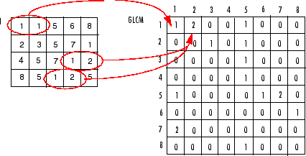
Features
Co-occurrence matrix
The graylevel co-occurrence matrix approach also frequently called the spatial gray level dependence matrix (SGLDM) approach is based on studies of the statistics of pixel intensity distributions. As hinted above with regard to the variance in pixel intensity values, single pixel statistics do not provide rich enough descriptions of textures for practical applications. Thus it is natural to consider the second-order statistics obtained by considering pairs of pixels in certain spatial relations to each

Slide 10
Conclusion
Selected features were used to fit trained to following classification models, best estimator parameters were obtained using grid search and predicted using test data:
Logistic Regression
K Nearest Neighbor classifier
Decision Tree Classifier
Random Forrest Classifier
Extra Tree Classifier
Support Vector Machines
Extra Tree Classifier and Support Vector Machine models had good category accuracy of 100% and f1 score of 1 with over all accuracy at 99.9%.
Support Vector Machine model performed better than other model during model training and unseen data classification.
For the problem statement able to make an automated image classifier system to replace manual image classifying process successfully.

Slide 11
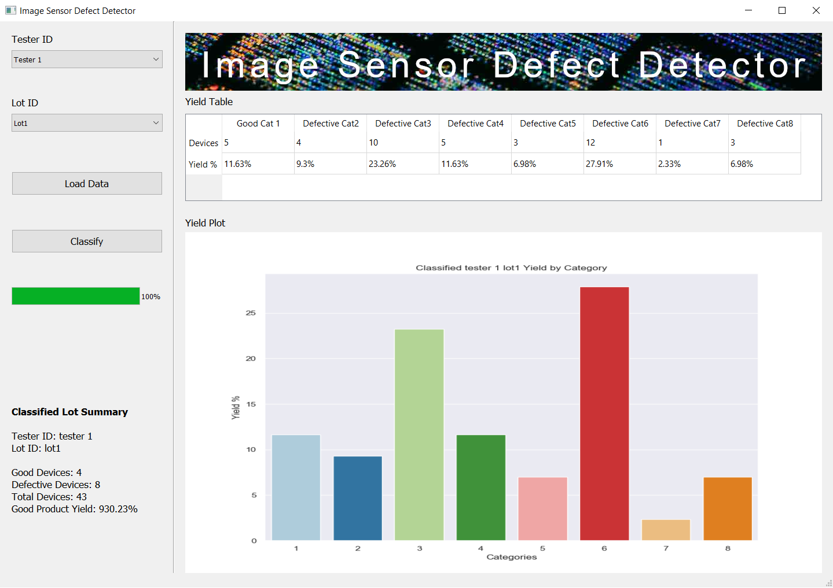
Deployment

